Slide 1
Digital Dream Journal with AI Interpretation By LucidVerse

Slide 2
Agenda
General Information | Survey, Business Need, Problem Statement
Situation AS IS | Current Processes, Technologies & Tools, SWOT Analysis
Potential solutions | Key features, Cost & Benefits Analysis
Recommended solution | Benefits, SWOT Analysis
Scope, Objectives | Scope, Objectives & Metrics
Stakeholders | Internal & External Stakeholders
Risk Assesment | Risk Category, Impact, Mitigation
From an idea to the product | Functional & Non-Functional Requirements, Use Case Diagram, Epic & User Story

Slide 3
- General Information -

Slide 4
Why a Dream Journal with AI Interpretation?
It all started with a simple question:
“How many people still write down their dreams?
And more importantly… what do they do with them?”
We launched an online survey validate the idea, with following topics:
General interest in dreams
User current habits
Interest in the proposed functionality
Valuable functionality components
Survey Link

Slide 5
Why a Dream Journal with AI Interpretation?
Here’s what we discovered:
75% of respondents are very interested in an app that combines a dream journal with AI interpretation
62% want a morning reminder to help them remember their dreams
61% see value in a personalized dream profile that includes analysis of emotions, symbols, and recurring themes

Slide 6
Why a Dream Journal with AI Interpretation?
Here’s what we discovered:
75% of respondents are very interested in an app that combines a dream journal with AI interpretation
62% want a morning reminder to help them remember their dreams
61% see value in a personalized dream profile that includes analysis of emotions, symbols, and recurring themes
These results showed us that:
There is a real and unmet emotional and cognitive need for this
type of solution
The solution is not just useful — it is expected and desired by the
target audience

Slide 7
- Situation AS IS -

Slide 8
Situation AS IS
Current processes:
Dream journaling
Interpreting dreams
Connecting dreams to emotional states
History and pattern analysis

Slide 9
Situation AS IS
Current processes:
Dream journaling
Interpreting dreams
Connecting dreams to emotional states
History and pattern analysis
Current technologies & Tools:
Notes apps (ex. Notes, Google Keep)
Existing dreaming apps
Online forums or groups

Slide 10
Situation AS IS
Main Limitations?
No digital integrated dream journaling solution
Non-personalized interpretations
No correlation between dreams and emotional state
No way to visualize recurring patterns

Slide 11
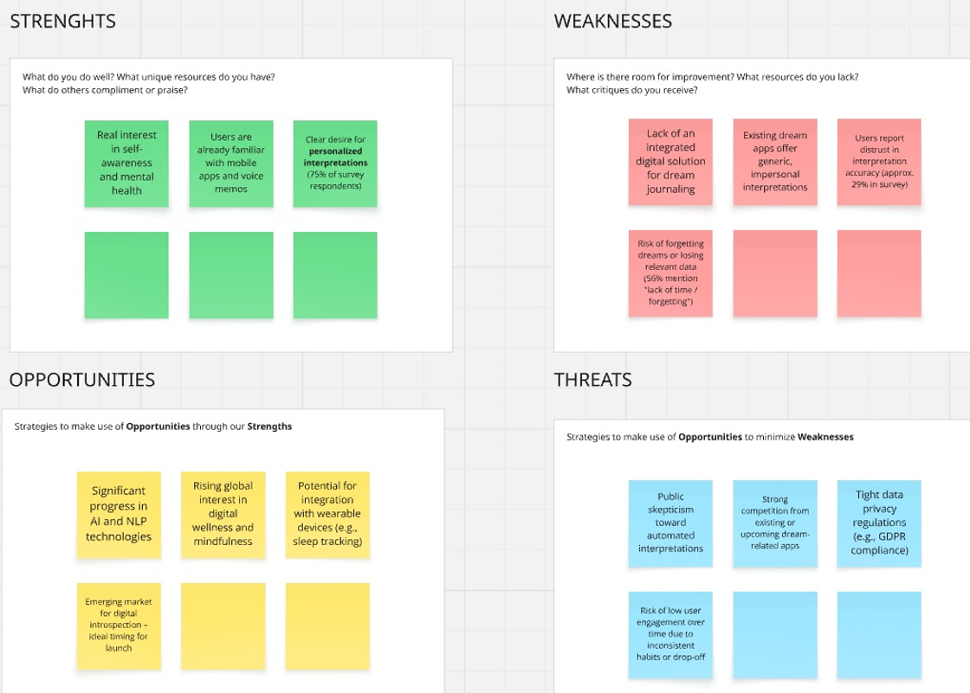
Situation AS IS SWOT Analysis

Slide 12
- Potential Solutions -

Slide 13
Solution 1 – Dream Journal with AI Interpretation
Key features:
Text / audio dream capture
Automatic & personalized AI dream interpretation
Dream tagging
Smart reminder
Interactive interface

Slide 14
Solution 1 – Dream Journal with AI Interpretation
Key features:
Text / audio dream capture
Automatic & personalized AI dream interpretation
Dream tagging
Smart reminder
Interactive interface
Benefits:
Increased personal value
Deep insight
High retention
Competitive advantage
Scalability

Slide 15
Solution 1 – Dream Journal with AI Interpretation
Cost:
Initial costs: 180.000 €
AI model development (theme analysis, symbols, emotions)
AI training on oneiric dataset
Dream capture (voice / text) and automatic transcription
Offline mode integration + local encryption
Annual operational costs: 90.000 €
AI maintenance and continuous improvements
Technical support and cloud infrastructure
Behavioral analysis and UX/UI tuning
Security audit and GDPR compliance

Slide 16
Solution 2 – AI Assistance & User Support
Key features:
AI interpretations based on detected symbols
Recommendation for sleep and mental hygiene
FAQ dream meanings
Suggestions for next actions in the app

Slide 17
Solution 2 – AI Assistance & User Support
Key features:
AI interpretations based on detected symbols
Recommendation for sleep and mental hygiene
FAQ dream meanings
Suggestions for next actions in the app
Cost:
Initial costs: 55.000 €
Annual operational costs: 20.000 €
Benefits:
Proactive useful suggestions and interpretations
Personalization based on user habits
Net benefit: premium positioning via “personal assistant”

Slide 18
Solution 3 – Security & Privacy
Key features:
Biometric authentication or password
Encryption of saved dreams
Possibility of private or anonymous public diary
Permanent deletion of dreams on demand.

Slide 19
Solution 3 – Security & Privacy
Key features:
Biometric authentication or password
Encryption of saved dreams
Possibility of private or anonymous public diary
Permanent deletion of dreams on demand.
Cost:
Initial costs: 30.000 €
Annual operational costs: 10.000 €
Benefits:
GDPR compliance
Personalized control of data
Net benefit: Increase loyalty and reduce legal risk

Slide 20
Solution 4 – Dream Export & Share Option
Key features:
Export in PDF, TXT, CSV format
Secure sharing (encrypted link or email)
Integration with note applications (ex. Notion, Evernote)
Cloud backup with restore option

Slide 21
Solution 4 – Dream Export & Share Option
Key features:
Export in PDF, TXT, CSV format
Secure sharing (encrypted link or email)
Integration with note applications (ex. Notion, Evernote)
Cloud backup with restore option
Cost:
Initial costs: 20.000 €
Annual operational costs: 7.000 €
Benefits:
Connecting with external application
Facilities sharing with therapist, friends and communities
Net benefit: applicability beyond individual use

Slide 22
Solution 5 – AI pshychological tests based on dreams
Key features:
Periodical questionnaires generated by AI
Dream-based assessment of emotional state
Periodical reports with psychological insights

Slide 23
Solution 5 – AI pshychological tests based on dreams
Key features:
Periodical questionnaires generated by AI
Dream-based assessment of emotional state
Periodical reports with psychological insights
Cost:
Initial costs: 52.000 €
Annual operational costs: 18.000 €
Benefits:
Regular assessments
Self-care tool
Net benefits: Positioning as a holistic wellbeing app & guided introspection

Slide 24
Solution 6 – Do nothing / Maintain the Status Quo
Key features:
Enter manually a dream by text or voice
Basic labeling and categorization
Simply statistics
No advanced functionality

Slide 25
Solution 6 – Do nothing / Maintain the Status Quo
Key features:
Enter manually a dream by text or voice
Basic labeling and categorization
Simply statistics
No advanced functionality
Cost:
Initial costs: 0 €
Annual operational costs: 5.000 €
Disadvantages
Persistent inefficiencies
Missed opportunities – no innovation
Net benefits: Short term savings, long term losses!

Slide 26
Recommended solutions

Slide 27
Solution 1 – Dream Journal with AI Interpretation
Main components:
Easy dream recording
Personal dream profile - AI detects themes, symbols, emotions
Personalized interpretation based on previous dreams
Smart reminder
Offline mode + encryption

Slide 28
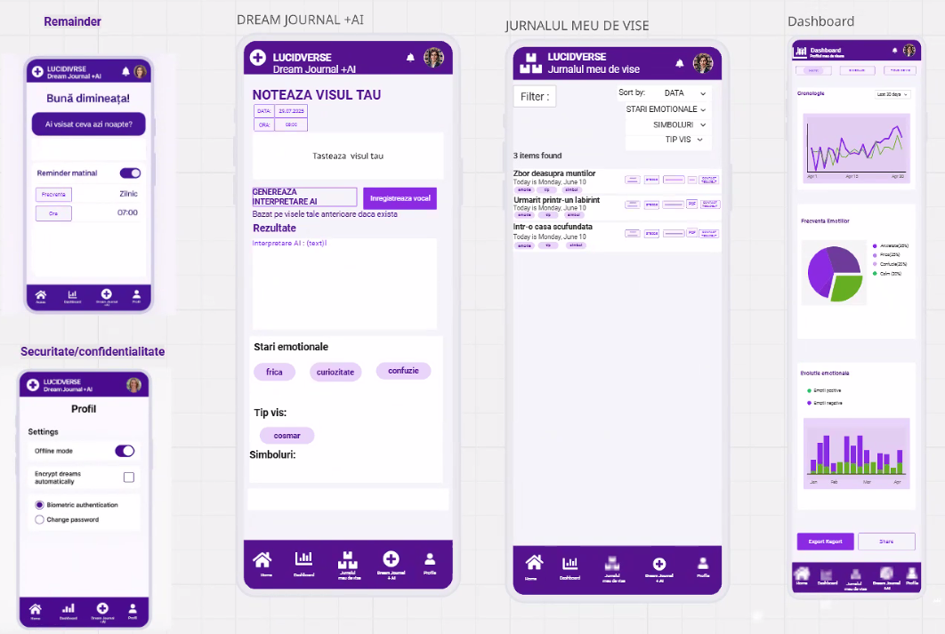

Slide 29
Solution 1 – Dream Journal with AI Interpretation
Benefits:
Increased user retention
Clear differentiation in the dreaming app market
Positive impact on mental health
Scalability and easy monetization
Create a valuable database

Slide 30
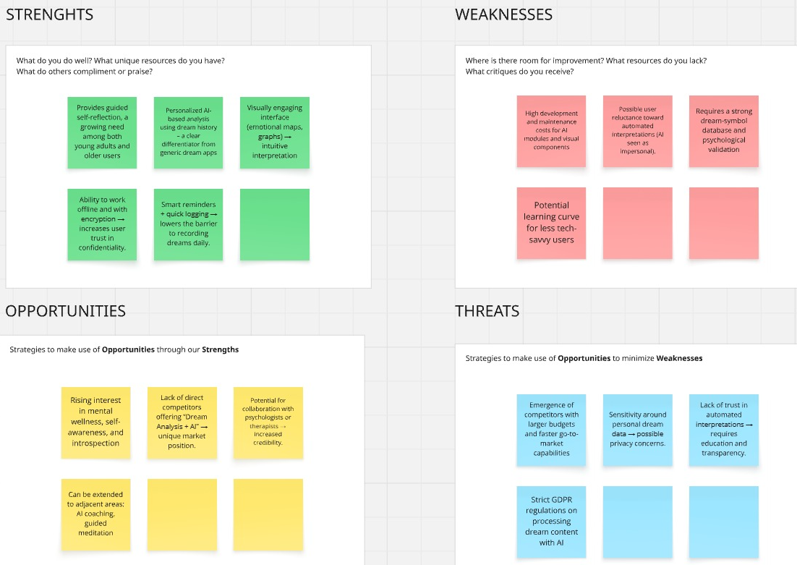
Dream Journal + AI Analysis SWOT Analysis

Slide 31
- Scope & Objectives -

Slide 32
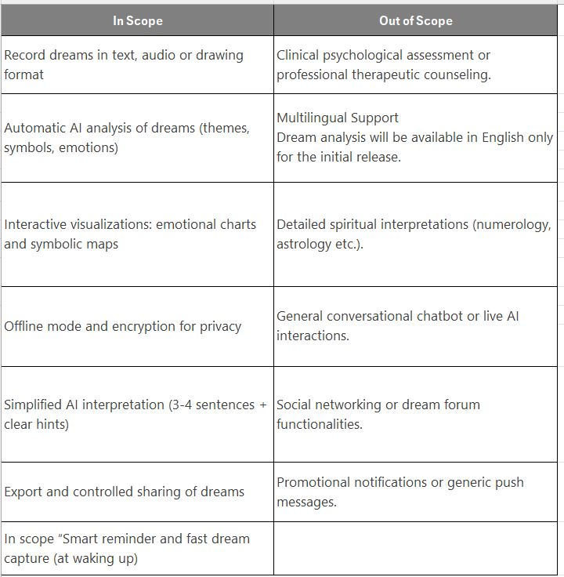
- Scope -

Slide 33
Objectives & Metrics
1. Increasing consistent use of the dream journal
* We want users to return regularly and record their dreams.
KPI: % of users who log dreams for at least 3 consecutive days
2. Providing automatic and relevant interpretation for each dream
KPI: Average AI interpretation generation time: ≤ 5 seconds
Successful interpretation completion rate (no errors): ≥ 98%
3. Delivering AI interpretations based on the user's dream history
KPI: At least 85% of users who have saved 3 or more dreams receive personalized AI-generated interpretations based on their individual history.

Slide 34
- Stakeholders -

Slide 35
Stakeholders - internal
Product Owner
Business Analyst
UX / UI Designer
Developer
AI Machine Learning Specialist
QA Tester
Marketing Team
Legal & GDPR Compliance

Slide 36
Stakeholders - external
End Users (young people + adults interested about mental health, self awareness)
Psychologist / partner therapist
Online community / beta testers
Investors / Founders
Technology providers
Education institutions or researchers

Slide 37
- Risk Assesment -

Slide 38
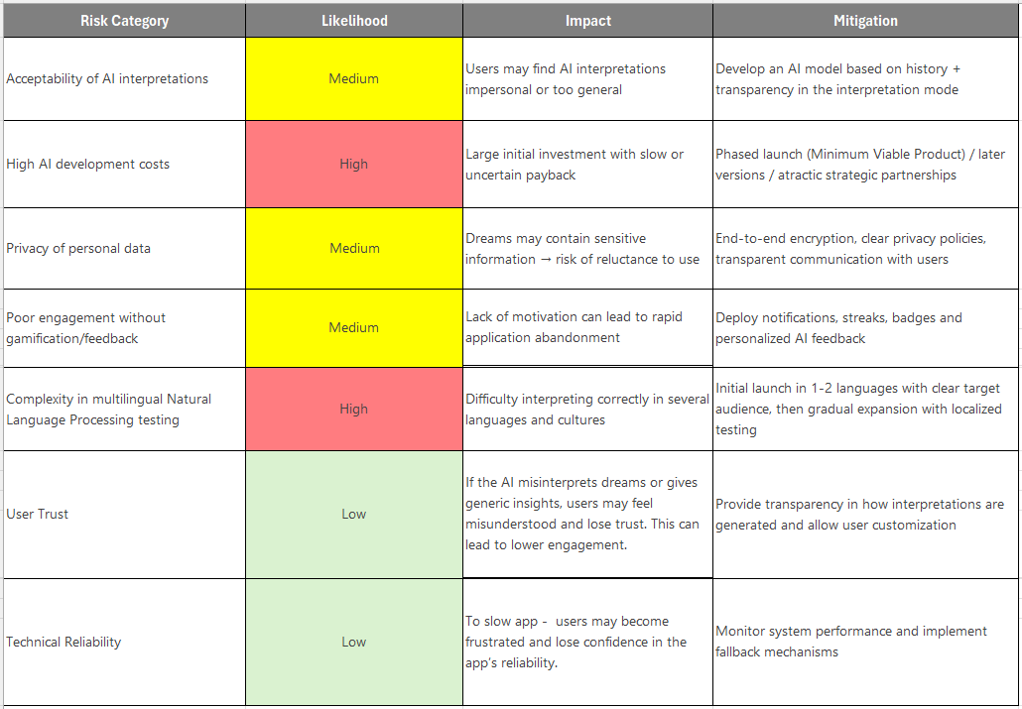
- Risk Assesment -

Slide 39

From idea to product…

Slide 40
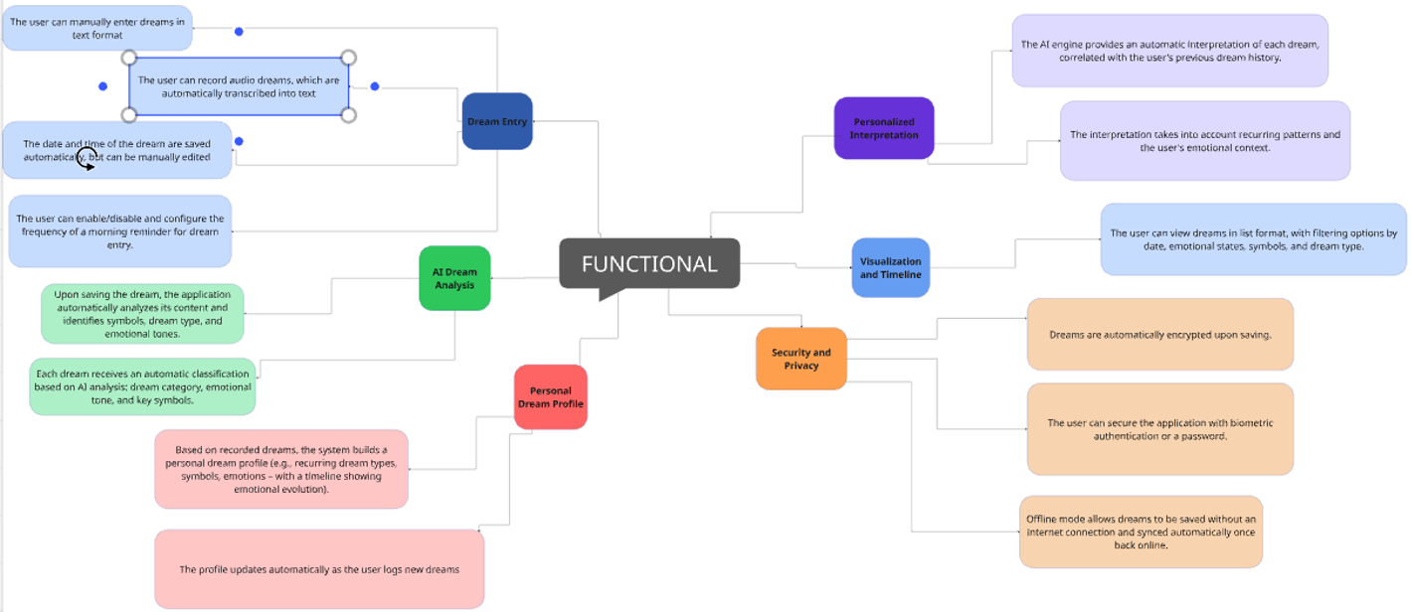
Functional Requirements

Slide 41
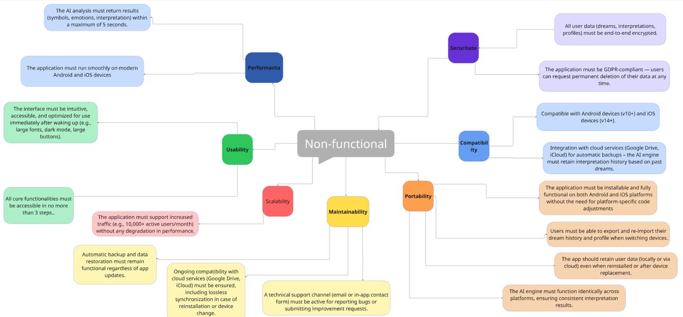
Non - Functional Requirements

Slide 43
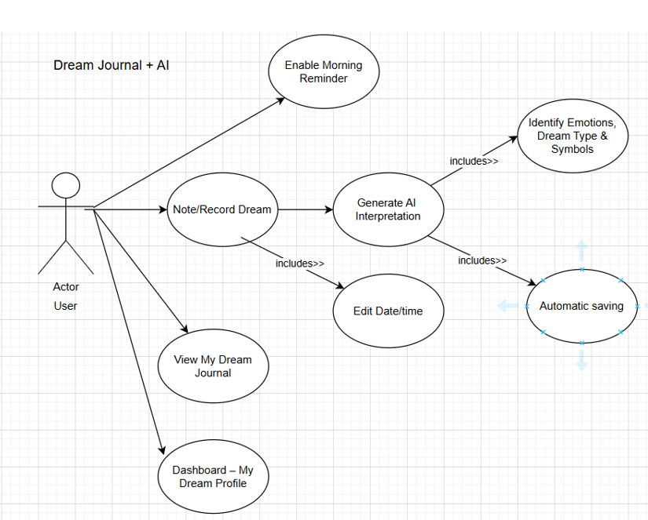
Use Case Diagram

Slide 44
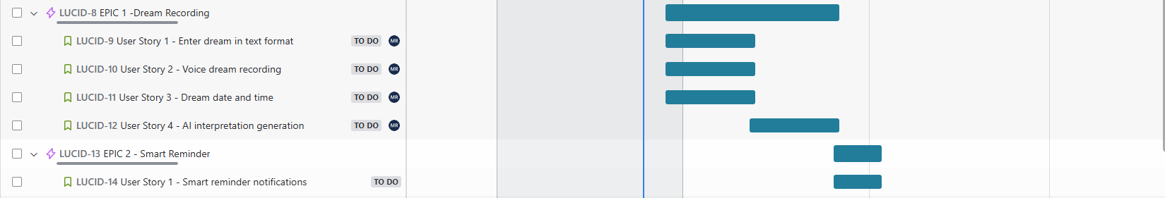
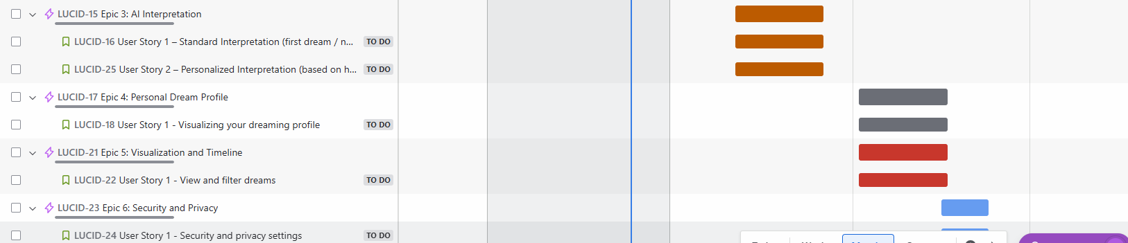
Epic & User Stories -Jira

Slide 45
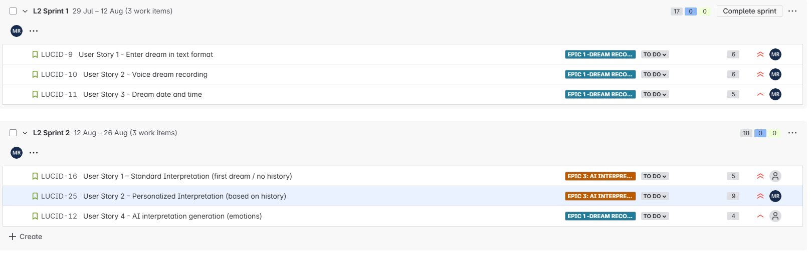
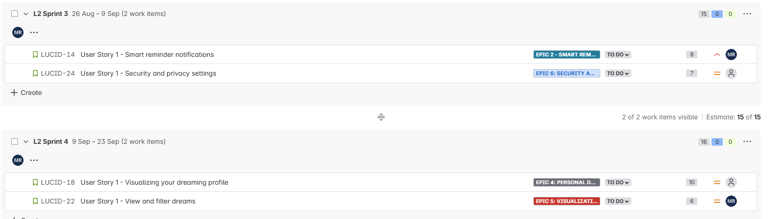
Sprint & User Story - Jira

Slide 46
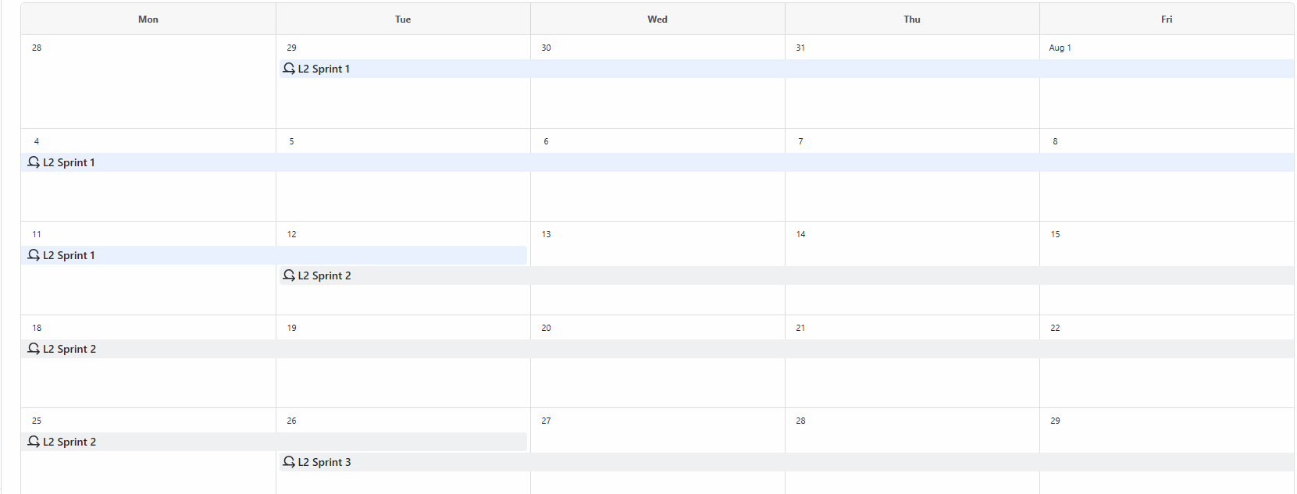
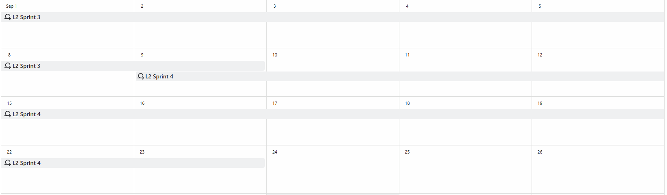
Sprint Planning Overview – Jira Calendar

Slide 47
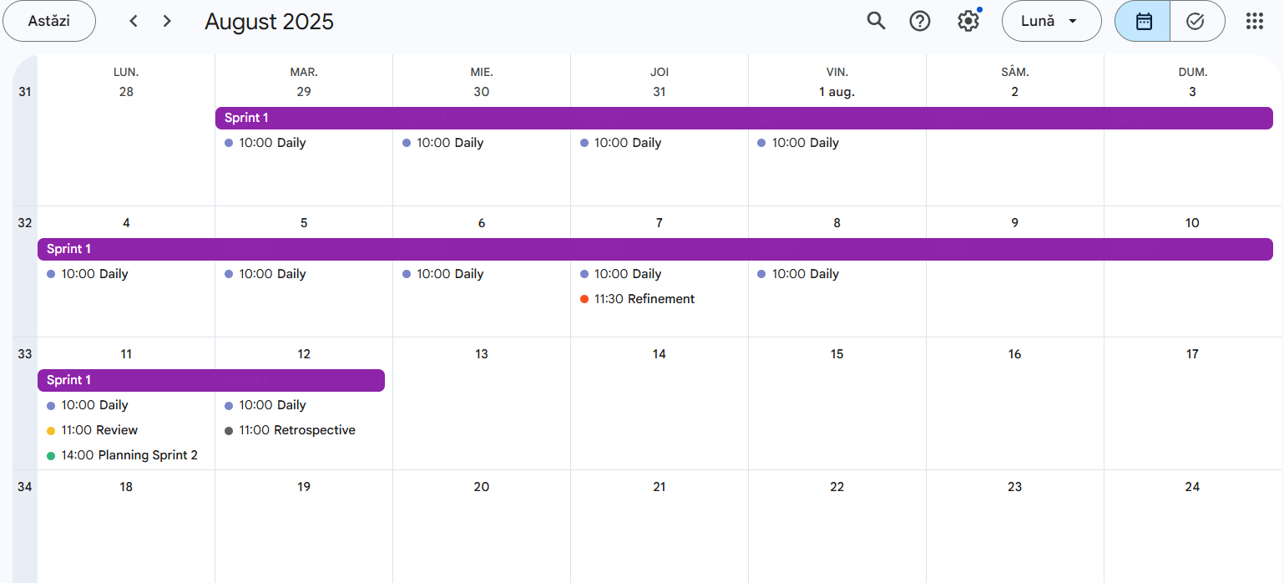
Sprint 1 Calendar- Digital Dream Journal with AI Interpretation

Slide 48
Confluence Documentation
And last but not least, following Confluence documentation:
Business Case_LucidVerse
Business Requirements Document (BRD)
Behavior Driven Development (BDD)
Confluence Link

Slide 49
Thank you!

